Slide 1
Final exam – cumulative
Chapters: 1,2,3,4,5,6,8,9,13,15 and 16 (Ch. 32 not included, that is, no bootstrap).
Monday, December 13 from 2 pm to 5 pm in room 201 at the Alumni Hall (AH 201). The entire class will be in the same room.

Slide 2
Examples Ch. 16

Slide 3
Example: Suppose the population standard deviation is 𝜎=5 , an SRS of 𝑛=100 is obtained, and the confidence level is chosen to be 98%. What is the margin of error for estimating a mean μ?

Slide 4
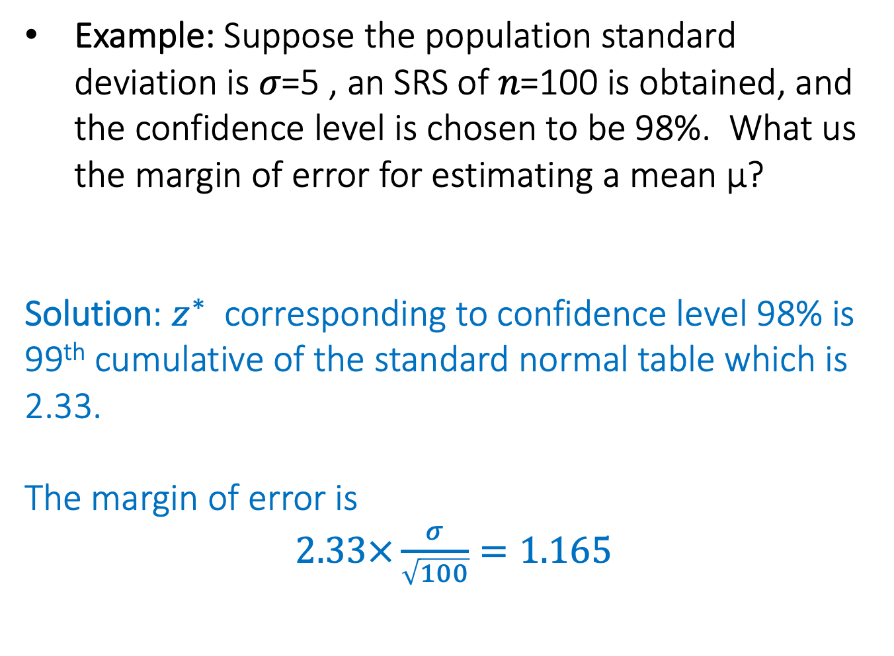
Example: Suppose the population standard deviation is 𝜎=5 , an SRS of 𝑛=100 is obtained, and the confidence level is chosen to be 98%. What us the margin of error for estimating a mean μ?
Solution: $z^{∗}$ corresponding to confidence level 98% is 99th cumulative of the standard normal table which is 2.33.
The margin of error is
$2.33×\frac{σ}{\sqrt{100}}=1.165$

Slide 5
Example: Suppose the population standard deviation is 𝜎=5 , an SRS of 𝑛=100 is obtained , and the confidence level is chosen to be 98%. The margin of error for estimating a mean 𝜇 is given by 1.165. What is the new sample size if we want to reduce the margin of error to 0.3883?

Slide 6
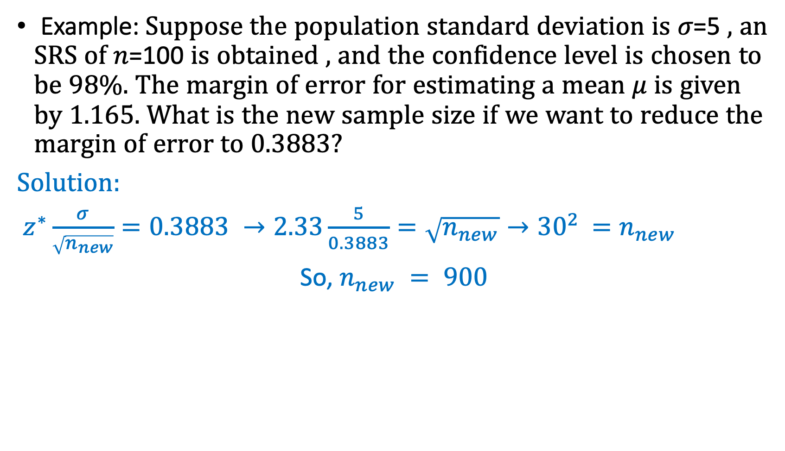
Example: Suppose the population standard deviation is 𝜎=5 , an SRS of 𝑛=100 is obtained , and the confidence level is chosen to be 98%. The margin of error for estimating a mean 𝜇 is given by 1.165. What is the new sample size if we want to reduce the margin of error to 0.3883?
Solution:
$z^{∗}\frac{σ}{\sqrt{n_{new}}}=0.3883 →2.33\frac{5}{0.3883}=\sqrt{n_{new}}→{30}^{2 }=n_{new}$
So, $n_{new} = 900$

Slide 7
Example: An SRS of size 𝑛0 was taken to estimate mean body mass index (BMI) for girls between 13 and 19 years of age. The 95% confidence interval obtained had the lower limit 19.5 and upper limit 26.3. Which statement is not true?
The margin of error is 3.4.
The value z∗ in the margin of error is 1.96
A total of 95% of all SRS of size 𝑛0 contain the true mean BMI
A total of 95% of all teenage girls have BMI between 19.5 and 26.3.

Slide 8
Example: An SRS of size 𝑛0 was taken to estimate mean body mass index (BMI) for girls between 13 and 19 years of age. The 95% confidence interval obtained had the lower limit 19.5 and upper limit 26.3. Which statement is not true?
The margin of error is 3.4.
The value z∗ in the margin of error is 1.96
A total of 95% of all SRS of size 𝑛0 contain the true mean BMI
A total of 95% of all teenage girls have BMI between 19.5 and 26.3.
Important: what does it mean to have a 95% confidence in this interval?
95% confidence means that this interval was produced using a process for which, in the long run, 95% of all samples of the same size give an interval that contains the actual mean BMI for girls between 13 and 19 years of age.
Solution:
True because interval is symmetric: 26.3-19.5 = 6.8/2 = 3.4
True because it is a 95% confidence interval, so z* must be 1.96
True, that’s what we mean by 95% confidence.
Not true, that is not what we mean by a 95% confidence interval.

Slide 9
Example: If the confidence level is increased from 90% to 99% for an SRS of size 𝑛 and population standard error 𝜎, the width of the confidence interval for the mean 𝜇 will:
Stays the same
increases
decreases
The answer can not be determined by the given information

Slide 10
Example: If the confidence level is increased from 90% to 99% for an SRS of size 𝑛 and population standard error 𝜎, the width of the confidence interval for the mean 𝜇 will:
Stays the same
increases
decreases
The answer can not be determined by the given information
Solution:
a) Because n and 𝜎 remain the same, the CI will increase because z* will be bigger for 99%

Slide 11
Example: Suppose we wish to compare lunch prices at two cities. We decide to sample 𝑛=50 lunches from each city, obtain the sample mean, and proceed to calculate confidence intervals with the same level of confidence. Which statement is true?
If the populations of all lunch prices have the same variance at both cities, the confidence intervals will be the same.
If the populations of all lunch prices at both cities have the same variance, the margins of error will be the same.
If the population of all lunch prices at one city has twice the standard deviation as the population at the other city, then we need to sample twice as many lunches to get the same margin of error.
All of the answer options are correct.

Slide 12
Example: Suppose we wish to compare lunch prices at two cities. We decide to sample 𝑛=50 lunches from each city, obtain the sample mean, and proceed to calculate confidence intervals with the same level of confidence. Which statement is true?
If the populations of all lunch prices have the same variance at both cities, the confidence intervals will be the same.
If the populations of all lunch prices at both cities have the same variance, the margins of error will be the same.
If the population of all lunch prices at one city has twice the standard deviation as the population at the other city, then we need to sample twice as many lunches to get the same margin of error.
All of the answer options are correct.
Solution:
Not true, confidence intervals won’t be the same because the sample means will be different.
True, margin of errors are the same because z*, n and 𝜎 are the same.
Not true, you need to increase your sample size 4 times (not 2) to get the same margin of error
z*2𝜎/sqrt(4*n) = z*2𝜎/2sqrt(n) = z*𝜎/sqrt(n)
d) Not true

